Slide 1




Kelly Handerhan
Your instructor:
CCSP, CISSP, PMP, CISM, CRISC, CISA
Class will begin at 2:00
A.M. Eastern Standard Time (EST)

Slide 2

CCSP Exam Details
Cloud Computing Concepts
Cloud Reference Architecture
Security Concepts Relevant to Cloud Computing
Design Principles of Secure Cloud Computing
Evaluate Cloud Service Providers

Slide 3
Cloud Data Concepts
Cloud Data Storage Architectures
Data Security Technologies and Strategies
Data Discover and Classification
Information Rights Management (IRM/DRM)
Data Retention, Deletion and Archiving Policies
Auditability, Traceability and Accountability of Data
Events

Slide 4


Certified Cloud Security Professional (CCSP)
Length of exam : 3 hours
Number of questions: 125
Exam format: Multiple Choice
Passing grade: 700 out of 1000
Exam availability: English
Testing center: Pearson VUE Testing Center

Slide 5
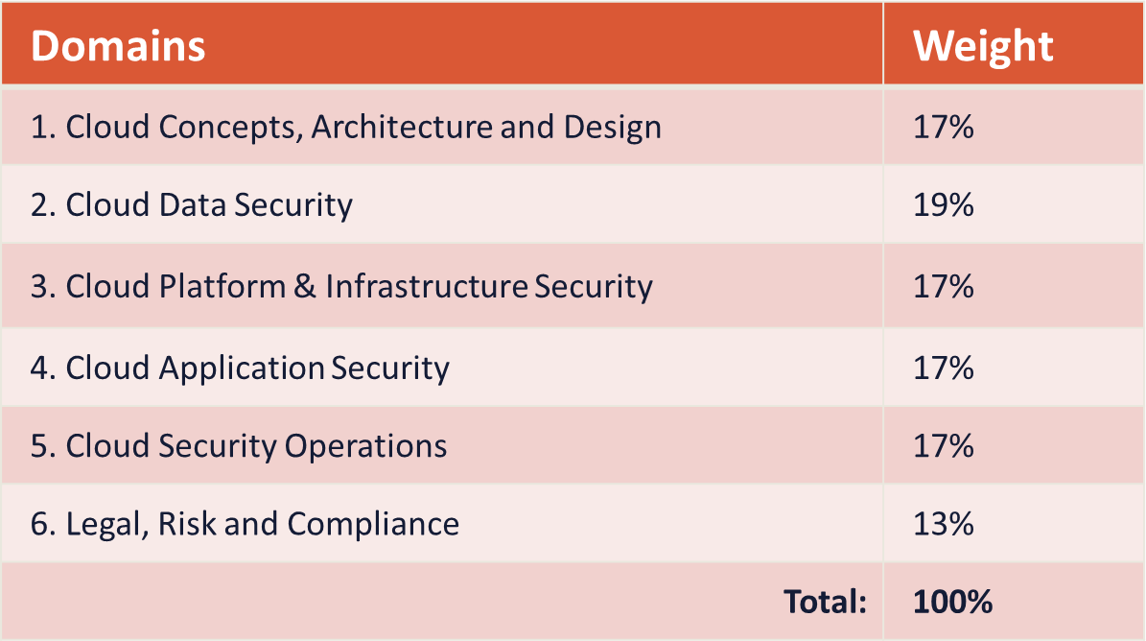

Slide 6






Slide 7



1.1 Understand Cloud Computing Concepts
Cloud Computing Definitions
Cloud Computing Roles (e.g., cloud service customer, cloud
service provider, cloud service partner, cloud service broker)
Key Cloud Computing Characteristics (e.g., on-demand self- service, broad network access, multi-tenancy, rapid elasticity and scalability, resource pooling, measured service)
Building Block Technologies (e.g., virtualization, storage,
networking, databases, orchestration)

Slide 8


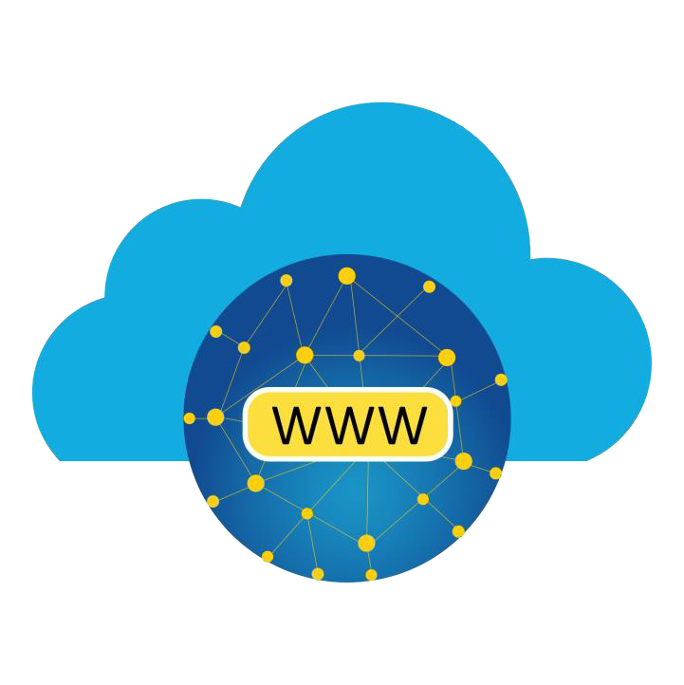
Cloud computing – A network-accessible platform model for enabling ubiquitous, convenient, on-demand network access to a shared pool of configurable computing resources (e.g., networks, servers, storage, applications, and services) that can be rapidly provisioned and released with minimal management effort or service provider interaction
Other definitions are covered throughout this course
Study references:
https://csrc.nist.gov/glossary
ISO/IEC 17788 “Cloud Computing – Overview and Vocabulary”

Slide 9



Cloud Service Customer (user) – the entity that is paying, leasing, renting, or trying cloud services. Also called the “consumer”
Cloud Service Provider (CSP) – the vendor that is providing the services from their data center, zones, regions, and edge computing locations. Examples: AWS, Rackspace, IBM Cloud, Microsoft Azure, and Google Cloud Platform
Cloud Service Partner – an entity with various partnership agreements with the CSP such as telecoms, broadband providers, Software-as-a-Service providers, and security solution vendors. Example AWS (GuardDuty) and Rapid7
Cloud Service Broker – an organization that buys hosting services from a CSP and then re-sells to their own consumers. Example: Direct Connect or ExpressRoute partners of AWS and Azure. Also “CASB”
Cloud Auditor – Typically third-party regulators who are ensuring compliance with frameworks such as PCI-DSS

Slide 10



On-demand self-service - the ability for a cloud consumer to provision resources automatically when needed with little or no intervention from the provider
Broad network access – consistent availability to cloud resources using a myriad of devices, locations, operating systems, with the help of load balancers, edge computing, and content delivery (distribution) networking (CDN)
Multi-tenancy - The ability to have multiple customers and applications running within the same environment in such a way that they are isolated from each other while often using the same physical resources
Rapid elasticity – allows customer to provision and de-provision cloud resources to
meet immediate needs, often in minutes
Scalability – the ability to leverage the massive amounts of resources of the cloud provider to add additional compute, storage, database, and networking
Resource pooling - the aggregation of resources allocated to cloud consumers by the
cloud service provider
Measured service - the delivery and billing of cloud services in a metered fashion

Slide 11



Using “bleeding-edge” CSP tech
Virtualization
Storage
Databases
Networking
Machine learning
Automation and orchestration

Slide 12
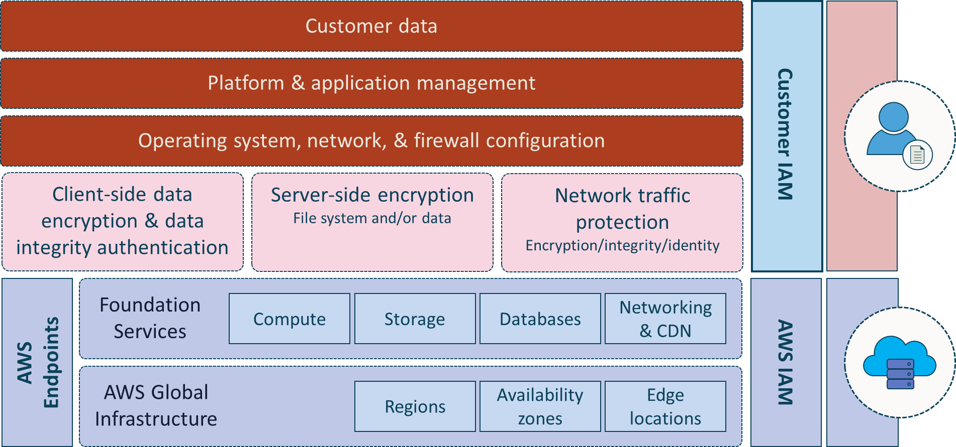

Slide 13
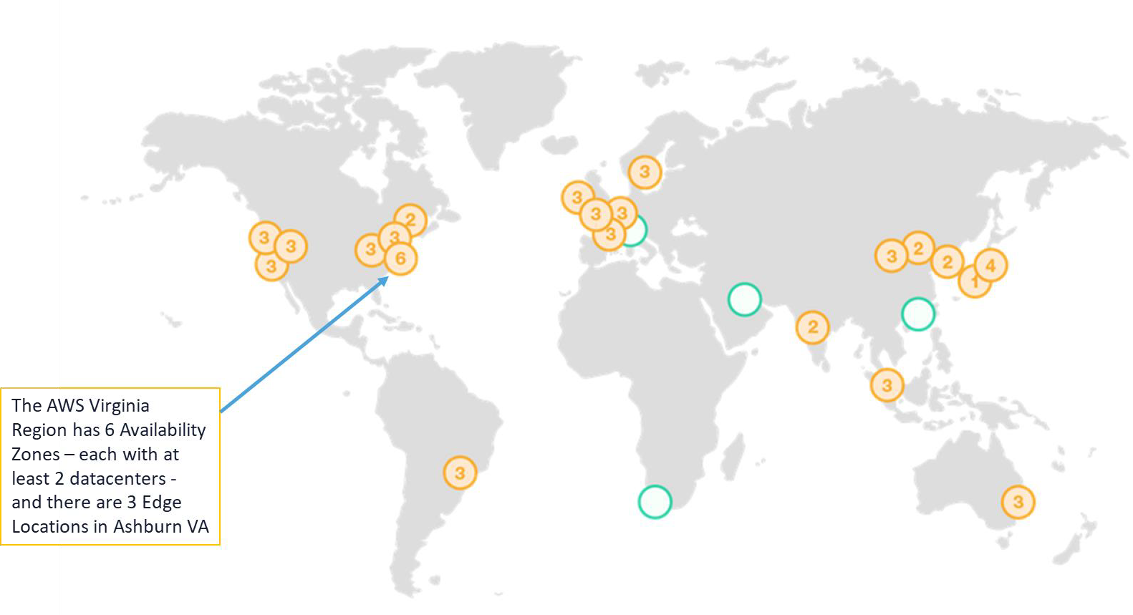

Slide 14
1.2 Describe Cloud Reference Architecture
Cloud Computing Activities and Capabilities (e.g., application capability types, platform capability types, infrastructure capability)
Cloud Service Categories (e.g., Software as a Service (SaaS),
Infrastructure as a Service (IaaS), Platform as a Service (PaaS))
Cloud Deployment Models (e.g., public, private, hybrid, community)
Cloud Shared Considerations (e.g., interoperability, portability, reversibility, availability, security, privacy, resiliency, performance, governance, maintenance and versioning, service levels and Service Level Agreements (SLA), auditability, regulatory)
Impact of Related Technologies (e.g., machine learning, artificial intelligence, blockchain, Internet of Things (IoT), containers, quantum computing)

Slide 15
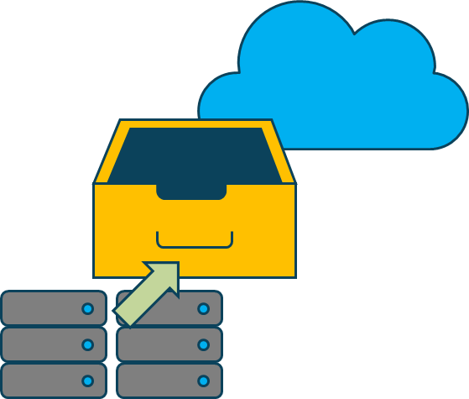
Archiving
Reasonably priced solutions for data archiving up to petabyte scale
Backup and restore
Durable and cost-effective choices for backup and disaster recovery
Blockchain
Shared ledgers for trusted connections between multiple entities
Business applications
Simplified management and lower cost business applications
Cloud migration
Fluid and simplified migration of applications and data to AWS
Containers
Fully managed services for workloads with Docker and Kubernetes
Content delivery
Low latency, cached delivery of web sites, APIs, and video content

Slide 16
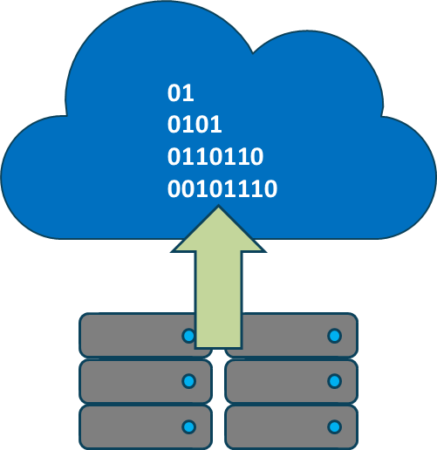
Database migrations
Time and cost-effective migration to managed and fully managed databases
Data Lakes and analytics
Secure, scalable, and cost-effective data lake and analytics services
DevOps
Rapidly and consistently build and deliver solutions using DevOps practices
E-Commerce
Highly scalable and secure offerings for online sales and retail businesses
High performance computing
Superior networking and cloud sized clusters for multifaceted challenges
Hybrid cloud architectures
Extend the on-premise IT infrastructure to the AWS cloud
Internet of things
Scale to billions of devices and messages with cutting-edge solutions

Slide 17

Machine learning
Leverage wide-ranging machine learning framework support
Mobile services
Solutions to help enable mobile application development at scale
Modern application development
Produce and advance applications through rapid innovation lifecycles
Remote work and learning
Modern solutions for remote teleworkers, students, and center agents
Scientific computing
Perform analysis, object storage, and distribution of enormous data sets
Serverless Computing
Build and run applications without needing underlying servers
Web sites
Use dependable, highly scalable, and affordable web application tools

Slide 18



“Infrastructure-as-a-service is where the capability provided to the consumer is to provision processing, storage, networks, and other fundamental computing resources where the consumer is able to deploy and run arbitrary software, which can include operating systems and applications.
The consumer does not manage or control the underlying cloud infrastructure but has control over operating systems, storage, deployed applications, and possibly limited control of select networking components (e.g., host firewalls)."

Slide 19






Slide 20

“Platform-as-a-service is the when the provided to the consumer is to deploy onto the cloud infrastructure consumer-created or acquired applications created using programming languages and tools supported by the provider.
The consumer does not manage or control the underlying cloud infrastructure including network, servers, operating systems, or storage, but has control over the deployed applications and possibly application hosting environment configurations"

Slide 21


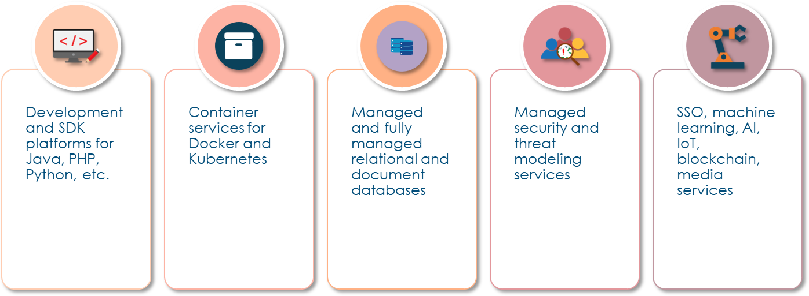

Slide 22

"The capability provided to the consumer is to use the provider's applications running on a cloud infrastructure. The applications are accessible from various client devices through a thin client interface such as a web browser.
"The consumer does not manage or control the underlying cloud infrastructure including network, servers, operating systems, storage, or even individual application capabilities, with the possible exception of limited user-specific application configuration settings."

Slide 23



Customer relationship management (CRM)
Human resources and workplace tools
Finance, sales, and marketing services
Payroll services
E-mail, collaboration, and cloud storage
Help & service desk
Virtual call center
Business analytics

Slide 24
A model where computing resources are owned and operated by a provider and shared across multiple tenants via the Internet or other public networks
Enterprises often use public cloud for less-sensitive applications that have unpredictable spikes in usage or for storing data that does not require frequent access
Public cloud makes computing resources available to anyone for purchase and multiple users usually share the use of a public cloud
Many businesses use a public cloud to scale existing IT resources on demand without having to commit to growing their physical IT infrastructure

Slide 25

A model that is dedicated to a single customer with no other sharing of cloud resources – not a multi-tenant environment
The private cloud can be a dedicated part of the Cloud Service Provider in a sandbox environment for an additional cost
The private cloud can be an on-premises solution using virtualization and other cloud service characteristics

Slide 26


A method for connecting infrastructure and applications between similar entities in a certain sector
Can be for public or private use
Often used to share information and research among parties with various types of agreements and cooperative relationships
Common examples are:
Government agencies and departments
Healthcare provider networks
Gaming communities
Insurance holding companies
Financial services companies

Slide 27
Technically a combination of private, public, and/or
community cloud deployments
Can also be a method for connecting infrastructure and applications between cloud-based resources and other resources that are not placed in the cloud
The most common type of hybrid deployment is
between the provider’s Public cloud and a standing on- premises enterprise Private cloud
Can be used to migrate, expand, or grow an organization's infrastructure into a cloud solution while linking internal systems to cloud resources
Often used by organizations to "burst up" to the cloud during peak demand times or special situations

Slide 28
The CSP as the producer and we as the consumer co-create value to deliver data, applications, services, and solutions to the world
Agility (flexibility) and elasticity
Reversibility
Cost
Security
Interoperability and portability
Availability vs. durability
Resiliency
Security and privacy
Performance
Governance and regulatory
Auditability
Maintenance and versioning
Service levels and Service Level Agreements (SLA)

Slide 29

Leveraging for rapid deployment, testing, experimentation, & innovation
Overcoming geographical limitations
Getting content as close to the consumer as possible
Reducing time and cost for testing and experimentation
Allows consumers better innovation

Slide 30

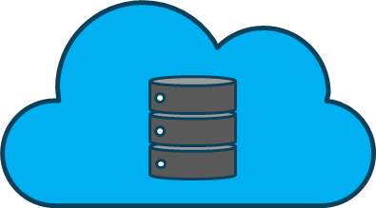
Elasticity is the ability to almost instantly provision and de-provision resources
Challenges with predicting demand leads to higher costs
Leveraging dynamic auto-scaling technologies
“Elasticity of the cloud allows us to add thousands of virtual servers and petabytes of storage within minutes, making such an expansion possible. Leveraging multiple AWS cloud regions, spread all over the world, enables us to dynamically shift around and expand our global infrastructure capacity, creating a better and more enjoyable streaming experience for Netflix members wherever they are."
- Yury Izrailevsky, VP Cloud and Platform Engineering, Netflix (from Netflix Media Center)

Slide 31
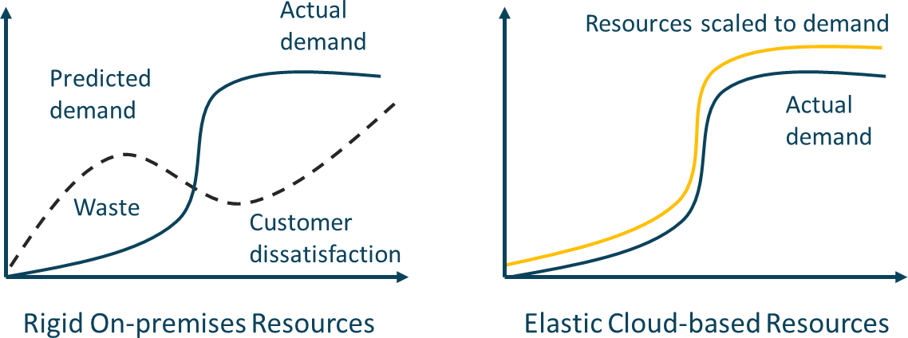

Slide 32

Resiliency should be considered a de facto aspect of cloud computing
Reliability is a measure of percentage uptime, considering the downtime due only to faults, whereas Availability is a measure of the percentage uptime, considering the downtime due to faults and other causes such as planned maintenance
For two different systems, it is possible for one system to be more reliable but less available than the other
Reliability of a workload in the cloud hinges on a few factors, the
primary of which is resiliency
Resiliency is the ability of a workload to recover from infrastructure or service disruptions
The customer should be able to dynamically obtain computing
resources to meet demand and mitigate disruptions
Disruptions can be misconfigurations or transient network issues

Slide 33

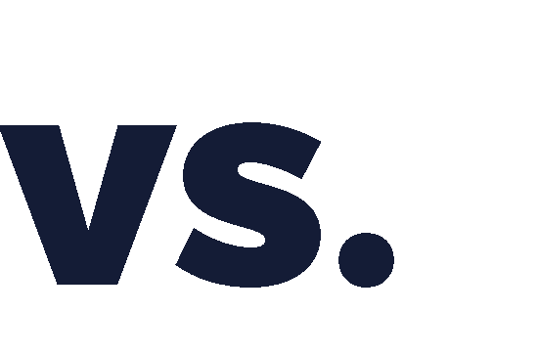

Availability and durability are two very different
aspects of data accessibility
Availability refers to system uptime (i.e., the storage system is operational and can deliver data upon request)
Historically, this has been achieved through hardware redundancy so that if any component fails, access to data will remain
Durability, on the other hand, refers to long-term data protection (i.e., the stored data does not suffer from bit rot, degradation or other corruption)
Rather than focusing on hardware redundancy, it is concerned with data redundancy so that data is never lost or compromised
Example: CSP standard object storage provides high levels of data durability and availability by automatically and synchronously storing data across both multiple devices and multiple facilities within a selected geographical region
AWS S3 and Google Cloud is designed for 99.999999999 percent (11 nines) durability per object and 99.99 percent availability over a one-year period
Microsoft Azure claims 12 nines and even 16 nines durability for some services

Slide 34
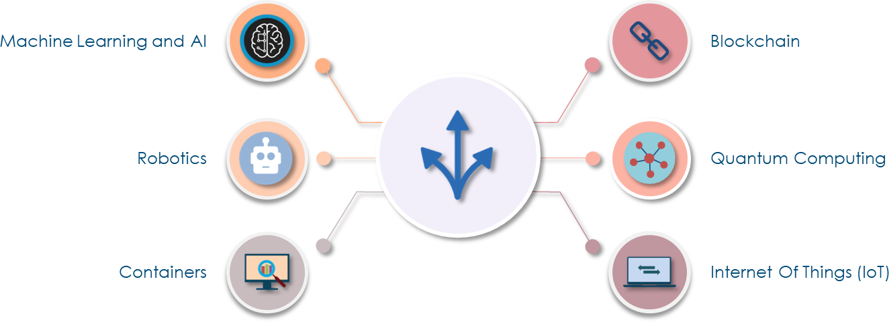

Slide 35


Refers to programs and machines acquiring, processing, correlating, and interpreting information
The results of ML and AI are applied in a myriad number of ways without direct input from programmers or users
There are a wide variety of cloud services that use machine learning algorithms and services:
Security automation
Language services
Intelligent contact centers and personalization
Intelligent search and document processing
Fraud detection
Media intelligence
Business forecasting

Slide 36

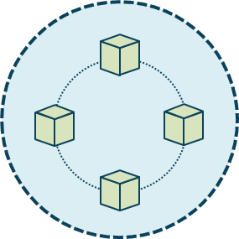
A public ledger consisting of a digital "chain of blocks"
storing information
Data can be read or write but not modified – changes must be made to a subsequent block in the chain
Transaction data such as date, time, and amount is verified
with a consensus mechanism (PoW, PoS, etc.)
The transaction participants identities are based on digital signatures
Unique cryptographic hashes are used to distinguish the
blocks from each other
These things must occur for a block to be added
A transaction must take place
The transaction must be verified (consensus)
That transaction must be stored in a block and given a hash

Slide 37

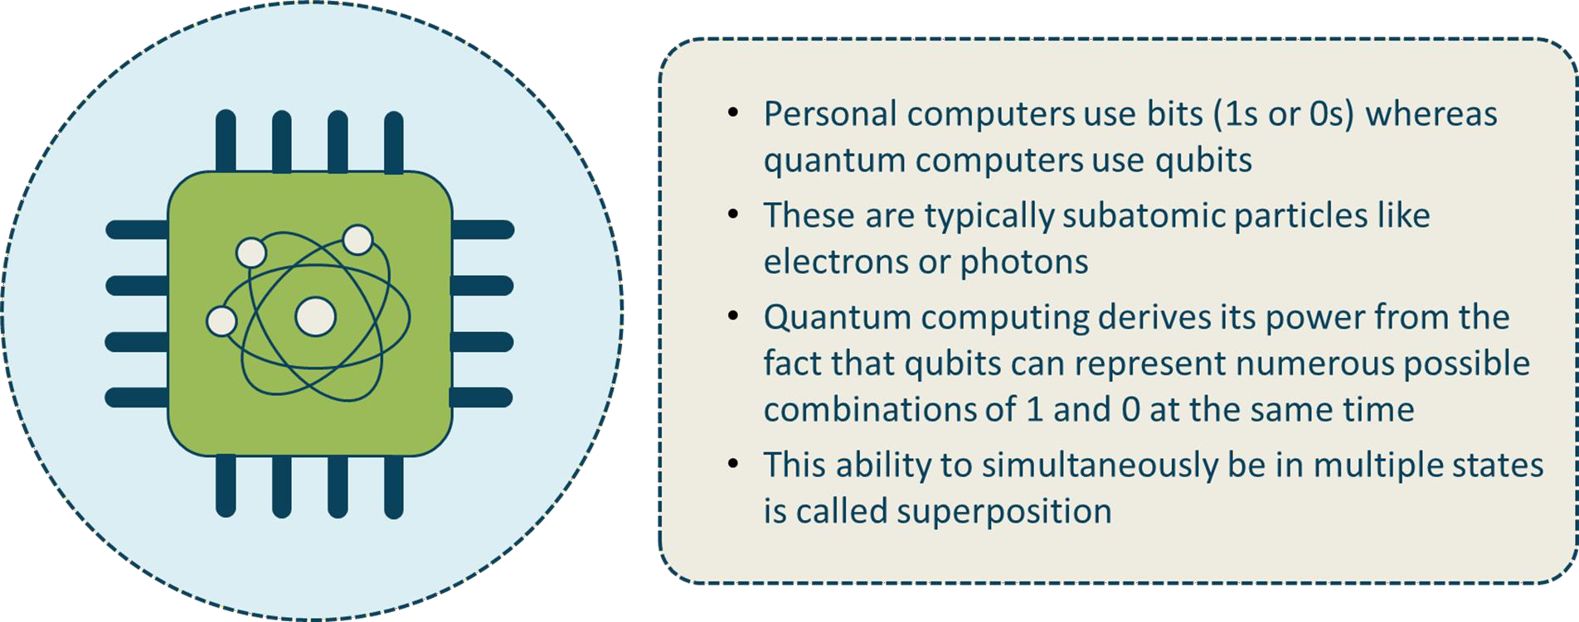

Slide 38

Containers
A method for packaging and securely running an application within an application virtualization environment
A container is a discrete modular and portable environment that includes the application binaries, software dependencies, and hardware requirements wrapped up into an independent, self- contained unit
You can also use containers for processes and workflows in which there are important requirements for security, reliability, and scalability
All cloud providers offer managed container development,
automation and orchestration services
Containers can be server-based or serverless (AWS Fargate)

Slide 39
1.3 Understand Security Concepts Relevant to Cloud Computing
Cryptography and Key Management
Access Control
Data and Media Sanitization (e.g., overwriting, cryptographic erase)
Network Security (e.g., network security groups)
Virtualization Security (e.g., hypervisor security, container security)
Common Threats

Slide 40

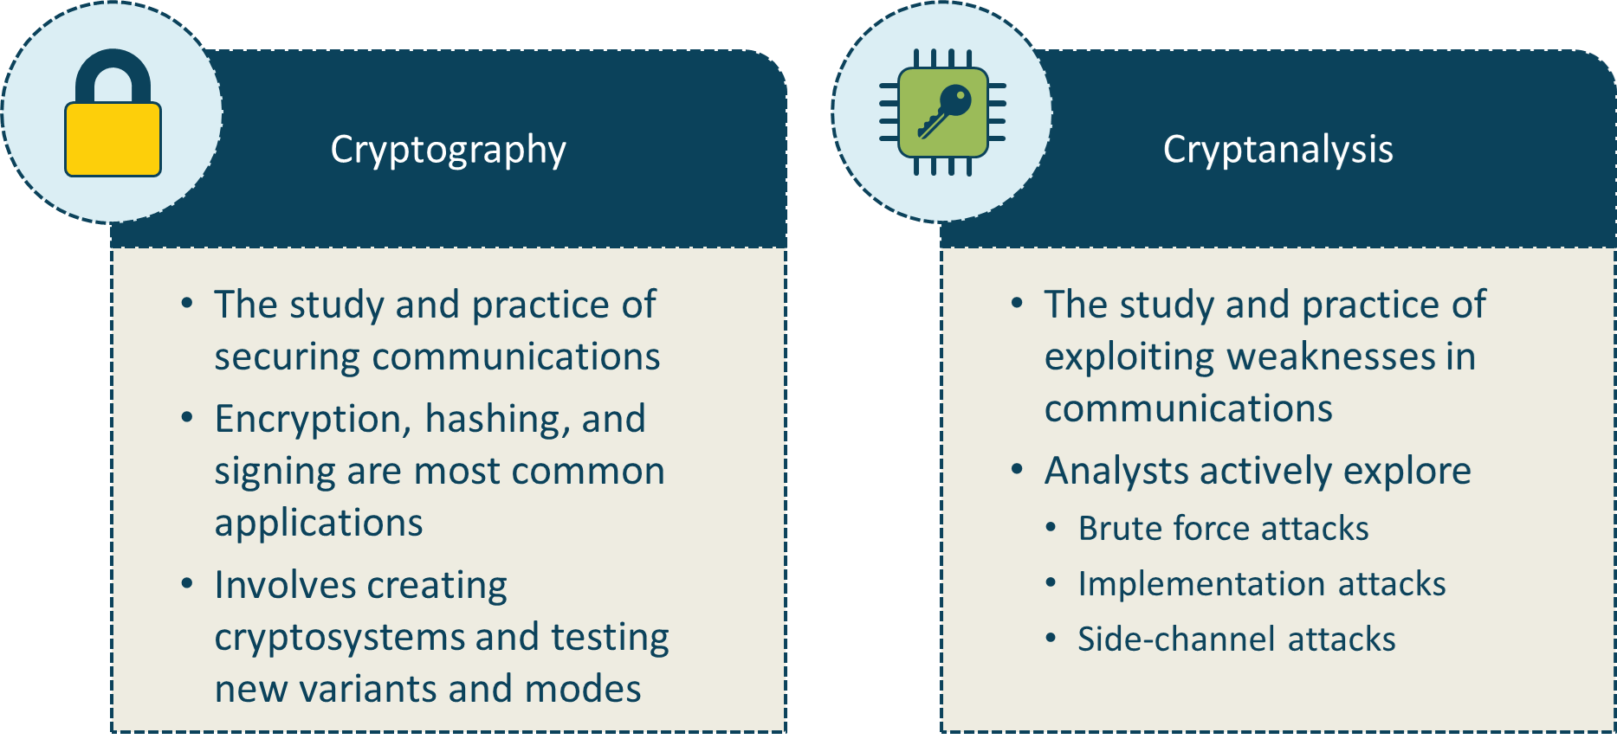

Slide 41


Protecting data at rest and data in transit
Confidentiality
Hiding the data at rest, in transit, and in use from unauthorized entities
Often involves a system that converts plaintext data into ciphertext
Integrity
Ensures the data has not been altered while at rest or in transit
Often involves attaching a cryptographic hash digest to the data
Authenticity
Cryptographic controls that involve origin authentication and identity
Non-repudiation
Ensures original sender cannot deny sending data or engaging in a digital transaction
Common to use digital certificates and digital signing

Slide 42


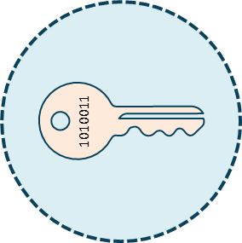
Uses the same key to encrypt and decrypt
Efficient, fast, computationally inexpensive, and
handles high data rates of throughput
Uses shorter key lengths (40 to 512 bits)
Key management is more complex and does not scale well
At a CSP, commonly used to protect storage and database data at rest as well as for TLS session keys for data in transit

Slide 43


Uses a mathematically related pair of a public and private key - if one is used to encrypt - the other is used to decrypt
Allows for efficient key management
Highly scalable with a public key infrastructure
Great for digital signatures and key exchange
Employs longer key lengths than symmetric
Slower and more computationally expensive
At a CSP, KMS can be used to generate key pairs for:
Encrypting and decrypting
Digitally signing

Slide 44
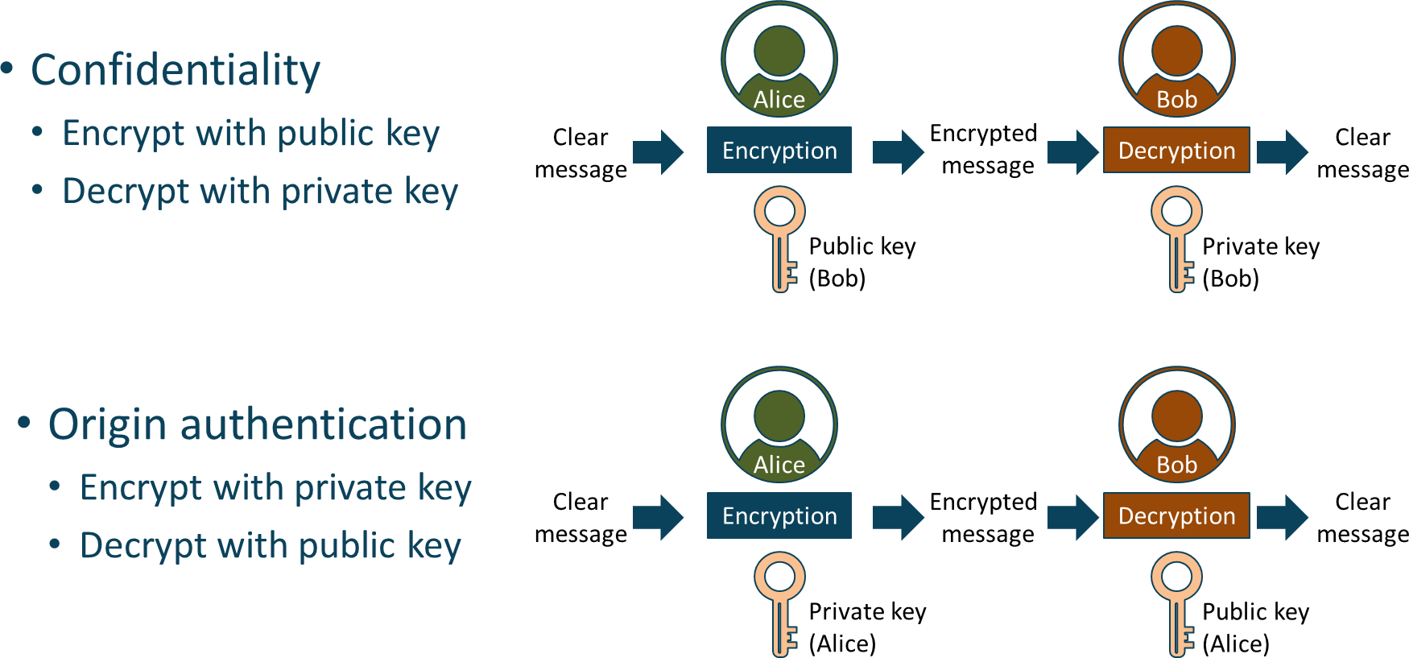

Slide 45
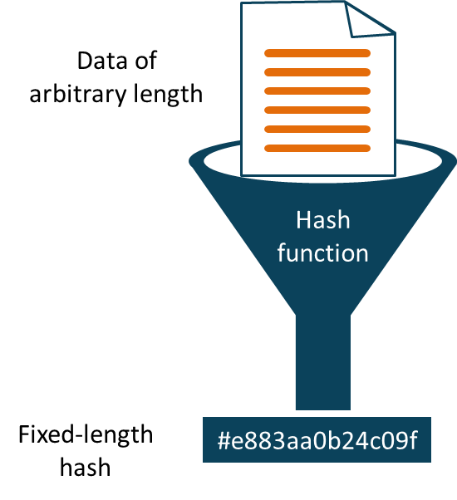
Converts data of any input size to a fixed-length string called a hash value, message digest, or fingerprint
An advanced version of a simple checksum
A one-way mathematical function that produces a digest of 128 to 512 bit
Birthday paradox and avalanche effect
Used in authentication, data integrity, non-repudiation, fingerprinting, and password storage

Slide 46
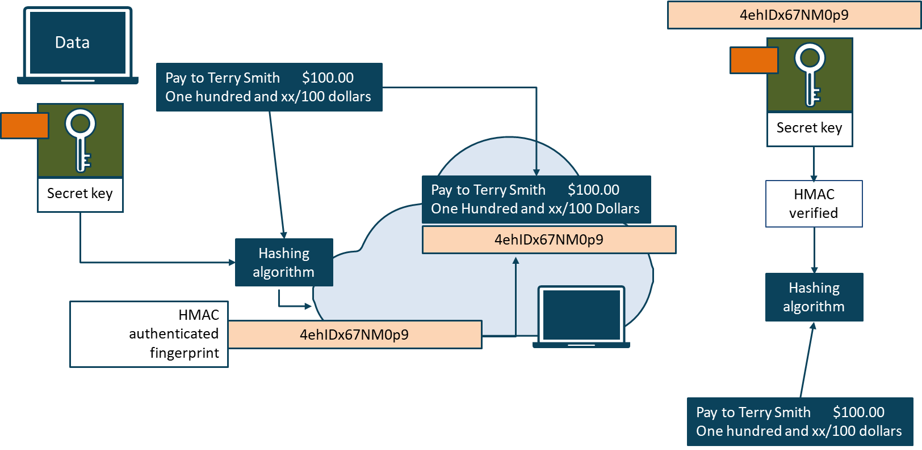

Slide 47
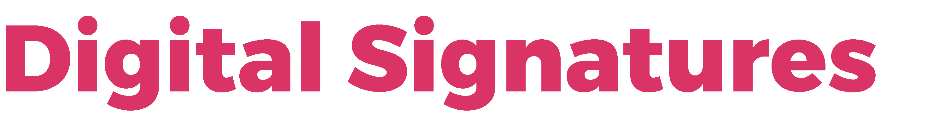
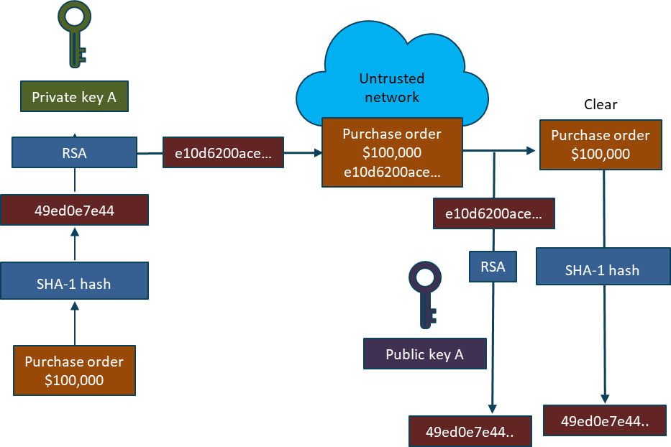
Scalable mechanism for providing authenticity, integrity, and non- repudiation
Does not offer confidentiality
Equivalent to a handwritten signature in many countries
Random private/public key pair
SHA1/2/3 hash algorithm
Signing algorithms
RSA (Rivest, Shamir, Adelman)
DSA (digital signature algorithm)
ECDSA

Slide 48



CSP key management is client-side, server-side, or KMS
Only authorized persons should be involved in the life cycle
Long-term storage is often done with HSM or CloudHSM
Removing keys from operation:
Destruction - removes an instance of a key in one of the permissible key forms at a specific location
Deletion – also removes an instance of a key, plus any data from which the key may be reconstructed, from its operational storage/use location
Termination - All instances and information of the key are completely removed from all locations, making it impossible to regenerate or reconstruct the key
Crypto-shredding (cryptographic erasure) - is the singular pragmatic option for disposal of keys and data/media in the cloud

Slide 49

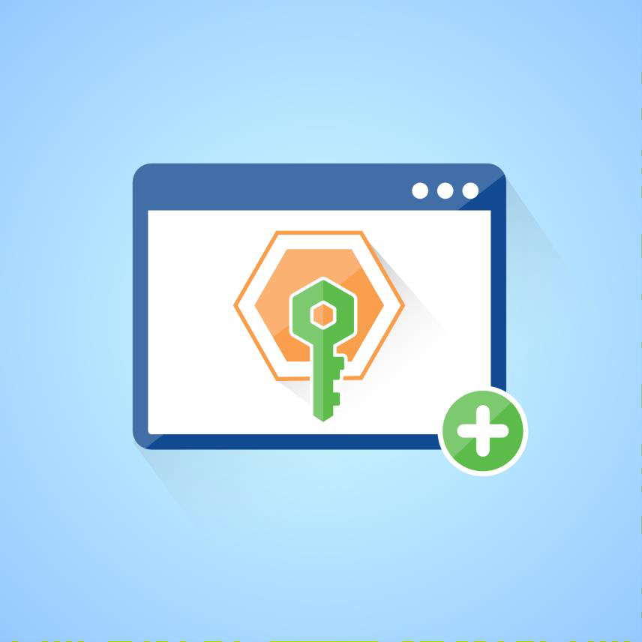
Combines Authentication, Authorization, and Accounting
Usernames (username or email) and passwords
Optional MFA
OTP card, YubiKey, software using Google Authenticator
Biometric fingerprint or retinal scan
Access key ID + access key for programmatic
access
Federated access and single-sign-on
SAML.2.0
Oauth + OIDC
Shibboleth

Slide 50

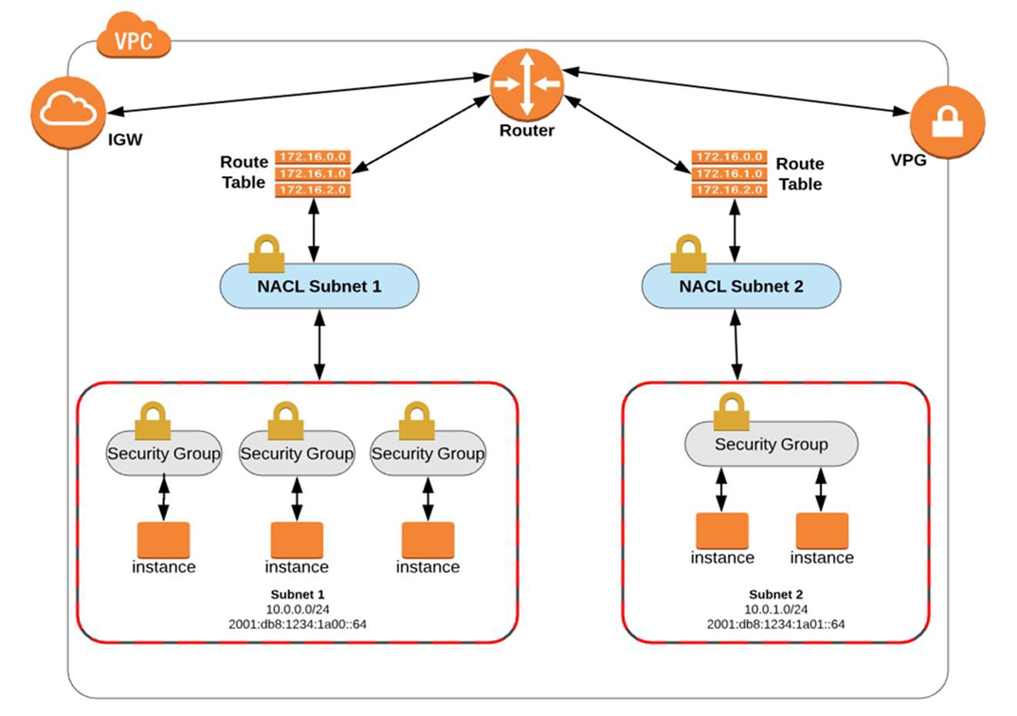
Subnet design (public, private, vpn)
Network ACLs (stateless L3/4)
Security Group FW (stateful L3/4)
Web Application Firewall (WebACL for HTTP(S)
Site-to-Site VPNs and Peer-to-Site VPNs (AWS Client Endpoints)
Elastic Load Balancer Security
Secure API endpoints
TLS web management access
Managed Threat Services

Slide 51

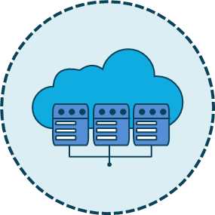
Virtualization is the process of running a virtual instance of a computer system in a layer abstracted from the underlying hardware server
It most often refers to running multiple operating systems on a computer system simultaneously
To the applications running on top of the virtualized machine, it can seem as if they are on their own dedicated operating system with libraries, DLLs, and associated programs

Slide 52

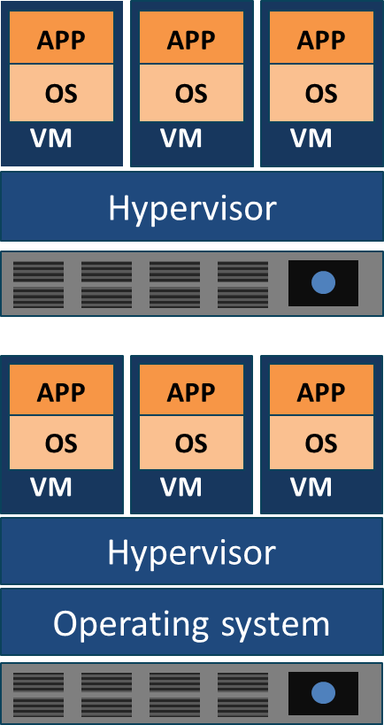
Software that runs virtual machines
Controls interaction between the VMs and the hardware
Type I - bare metal or native
Runs directly on the underlying hardware
XenServer, KVM, Hyper-V, ESXi
Type II - hosted
Runs on the OS installed on the hardware
Oracle VirtualBox 6, VMWare Player/Workstation

Slide 53
VM sprawl
When the number of VMs overtakes the administrator's ability to manage them and the available resources
VM sprawl avoidance
Enforce a strict process for deploying VMs
Have a library of standard VM images
Archive or recycle under-utilized VMs
Use a Virtual Machine lifecycle management tool or a cloud service provider-managed service
VM escape
A serious threat where a process running in the guest VM interacts directly with the host OS
VM escape protection
Patch VMs and VM software regularly
Only install what you need on the host and the VMs
Install verified and trusted applications only
Strong access control policies and passwords

Slide 54


Data breaches
Insufficient identity, credential
and access management
Insecure interfaces and APIs
System vulnerabilities
Account hijacking and cryptojacking
Malicious insiders
Advanced persistent threats
Data loss
Insufficient due diligence
Abuse and nefarious use of cloud services
Denial of service (DDoS and botnets)
Shared technology vulnerabilities
“The Treacherous Twelve: Cloud Computing Top Threats” from the Cloud security Alliance (CSA)

Slide 55
1.4 Understand Design Principles of Secure Cloud Computing
Cloud Secure Data Lifecycle
Cloud based Disaster Recovery (DR) and Business Continuity (BC)
planning
Cost Benefit Analysis
Functional Security Requirements (e.g., portability, interoperability,
vendor lock-in)
Security Considerations for Different Cloud Categories (e.g., Software as a Service (SaaS), Infrastructure as a Service (IaaS), Platform as a Service (PaaS))

Slide 56

From NIST SP 8oo-37
CATEGORIZE
Information System
MONITOR
Security Controls
SELECT
Security Controls
Define criticality/sensitivity of Information system according to potential worst-case, adverse impact to mission/business.
Continuously track changes to the information system that may affect security and
reassess control effectiveness.
Select baseline security controls; apply tailoring guidance and supplement
controls as needed based on risk assessment.
Security Life Cycle
AUTHORIZE
Information System
IMPLEMENT
Security Controls
Determine risk to organizational operations and assets, individuals, other organizations,
and the Nation; if acceptable, authorize operation.
ACCESS
Security Controls
Implement security controls within enterprise architecture using sound systems engineering practices; apply
security configuration settings.
Determine security control Effectiveness (i.e., controls implemented correctly,
operating as intended, meeting security requirements for information system. )

Slide 57
Create
Destroy
Store
Archive
Use
Share

Slide 58


There are two aspects to consider with BCP and DR:
The continuity of operations and disaster recovery responsibilities of the cloud provider and
The customer using the CSP for their own business continuity, site resiliency, and disaster recovery

Slide 59
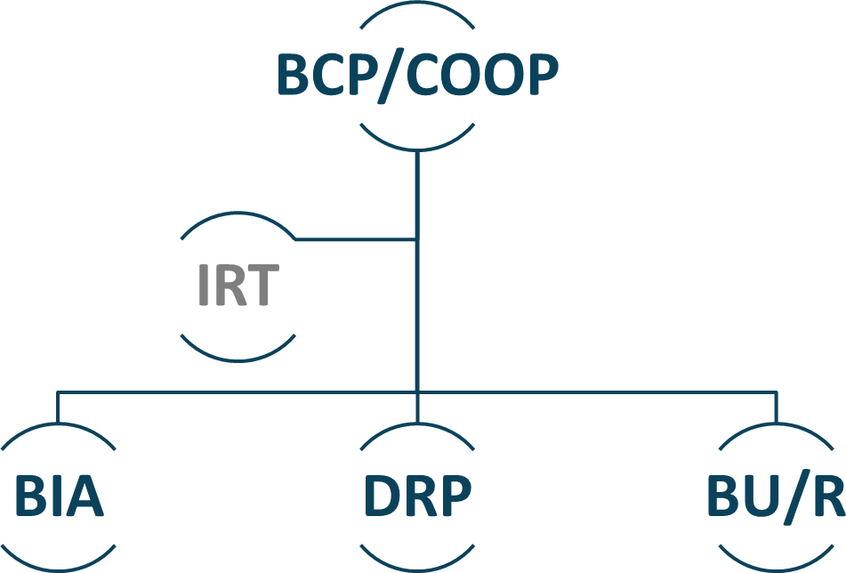

Slide 60

This should be conducted early in the security management lifecycle
NIST SP 800-30 Risk Management Guide for Information Technology Systems states:
If control would reduce risk more than needed, then see whether a less expensive alternative exists
If control would cost more than the risk reduction provided, then find something else
If control does not reduce risk sufficiently, then look for more controls or a different control
If control provides enough risk reduction and is cost- effective, then use it
After identifying all possible controls and evaluating their feasibility and effectiveness, enterprises should allocate resources and implement cost-effective controls based on cost- benefit analysis
The CBA can be qualitative or quantitative based
on risk management methodologies
The goal is to demonstrate that the costs of implementing the controls can be justified by the reduction in the level of risk
For example, the organization may not want to spend
$10,000 on a control to reduce a $2000 risk

Slide 61





Portability (cloud-based) - is the ability to move applications, containers, code, and associated data from one CSP to another or between legacy on- prem environments and the cloud
Interoperability – when the customer application does not function properly when changes are made to an environment; more common in a PaaS scenario since the O/S is managed and updated by the provider
Vendor lock-in – a scenario where the consumer is unable to retain, migrate, or transfer to another provider based on technical or non- technical restrictions
Vendor lock-out – A situation where the customer is not able to recover or access their own data due to a vendor going out of business, going bankrupt, or legal holds are implemented

Slide 62



The cloud customer has the highest degree of responsibility for security:
Network design and firewalls
Operating system and applications
Data encryption (client-side vs. server-side)
Data protection
CSP will secure the facility and datacenter – everything at Layers 1 and 2 of the OSI model including the hypervisors
Customer has limited visibility and monitoring of the provider site and datacenter which makes audits challenging – must rely on third-parties
Must be negotiated in early negotiations
Some activities may be prohibited by regulations such as Cloud-based HSM instead of on-prem HSM

Slide 63

The customer loses additional control when using platform-as-a-service since the provider installs, manages, upgrades, updates the operating systems, database systems, and even some applications
There is more gray area with managed and “fully- managed” services (example: AWS Aurora vs. RDS MySQL)
SLA’s and policies must be more structured and customized, especially when regulatory compliance is involved
Customer should have adequate monitoring and
metering when using PaaS

Slide 64


Practically all control is assumed by the service provider
The consumer will only create, deliver, and modify data delivered to the cloud system
Often, the applications are being rendered via XML or web-based tools on the client system or VDI environment
Customer has limited administrative rights, elevated
privileges, permissions, and authorization
Consumer may still have contractual responsibilities for safeguarding data and federated access therefore a Cloud Access Security Broker (CASB) is often employed to assist SaaS solutions

Slide 65
1.5 Evaluate Cloud Service Providers
Verification Against Criteria:
International Organization for Standardization/International Electrotechnical Commission (ISO/IEC) 27017 offers a set of standards for provisioning controls for cloud services and cloud service customer information and privacy
Payment Card Industry Data Security Standard (PCI DSS) is for entities that process major credit or bank card transactions; some cloud
providers will be “PCI-compliant”
Common Criteria (CC) offers assurance and certification that the descriptions, implementation and evaluation of a cloud provider service is performed in a rigorous and repeatable manner that adequately maps to its target use environment
Federal Information Processing Standard (FIPS 140-2) is a standard that will is used by Federal organizations when cryptographic-based security systems are used to provide confidentiality, integrity, and non- repudiation for sensitive or valuable data

Slide 66

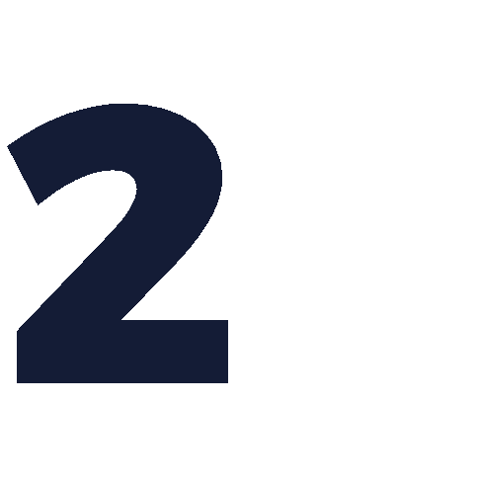

Slide 67
2.1 Describe Cloud Data Concepts
Cloud Data Life Cycle Phases
Data Dispersion

Slide 68


Phase 1: Create
Data is either generated from scratch, inputted, or modified into another format either locally or in the cloud
If created locally it may need to be sent over IPsec or TLS VPN (S2S or P2S) or the customer can perform client-side encryption and send over a clear channel
The data owner is identified in the create phase
Other key activities of phase one include:
Data discovery
Data categorization
Data classification
Data mapping
Data labeling (tagging)

Slide 69


Phase 2: Store
After the Create phase, the data is put into a volume (block)/object storage system or into one of several types of database systems
This phase relates to transactional, near-term usage data as opposed to long-term cold data storage
It also includes files and spreadsheets, typically done at during or at the end of the Create phase
Activities of this phase can also occur simultaneously when the data is generated in phase one
Protection of data at rest and data in transit will often occur in this phase unless default encryption is implemented in the Create phase

Slide 70
as being changed from the original state
Data is utilized by people, applications, and tools as well
Phase 3: Use
Raw data becomes information
If data is used remotely then protection mechanisms must be in place (VPN, secure endpoints, digitally signed API calls)
The systems that “use” the data must be secured as well; for example, endpoint detection and response (EDR) or host-based IPS agents (Palo Alto Traps)
Technologies like VPN, Identity Rights Management (IRM), and Data Loss Prevention (DLP) engines may be introduced
Assistance can come form a Managed Security Service Provider (MSSP) or Cloud Access Security Broker (CASB)

Slide 71

Phase 4: Share
Data is visible, analyzed, and apportioned among users, systems, and applications
Global collaboration and sharing of data introduces obvious risks and lack of control
Most of the control used in the previous phases will be implemented here in phase four (such as IRM and DLP services)
Stringent Identity and Access Management (IAM) and/or Identity Management (IdM) should be used to enforce the least privilege principle in line with access control model (DAC, RBAC, MAC, ABAC, etc.)
It may be beneficial to implement egress DLP on the email message transfer agents (MTA) to and from the cloud provider and partners using the same CSP

Slide 72
Phase 5: Archive
Data is stored for long-term and removed from active usage
It can be sanitized based on policy
Stringent cryptography will be introduced for data
at rest – as in AES-GCM-256 AEAD solutions
Archiving is often automated and based on governance or regulations for example AWS S3 Intelligent Tiering or Storage Gateway management over a Direct Connect link
Factors in choosing long-term storage:
Location
Media format
Staffing
Operating procedures

Slide 73
Phase 6: Destroy
Data is no longer accessible or usable based on lifetime, utility, policy, governance, and/or regulations
Although data can be disposed of using a variety of methods, when storing data at a CSP, cryptoshredding (cryptographic erasure) is the only practical and comprehensive solution
The provider will have their own established methods for disposal of data and media, often using military grade programs or physical destruction

Slide 74

Data dispersion is a method that is often used to increase
data security, but without the use of encryption
Dispersion is like legacy RAID in that data is spread across different storage areas and even different cloud providers in disparate geographic locations
However, if data is spread across multiple cloud providers, an outage at one could make the dataset unavailable to users, regardless of location
Bit splitting is like adding encryption to RAID where the data is first encrypted, then separated into chunks, and the pieces are distributed across several storage areas
Erasure coding is like using parity bits for RAID striping and helps you recover missing data if cloud data is unavailable/lost while your data is dispersed

Slide 75
2.2 Design and Implement Cloud Data Storage Architectures
Storage Types (long term, ephemeral, raw-disk)
Threats to Storage Types

Slide 76
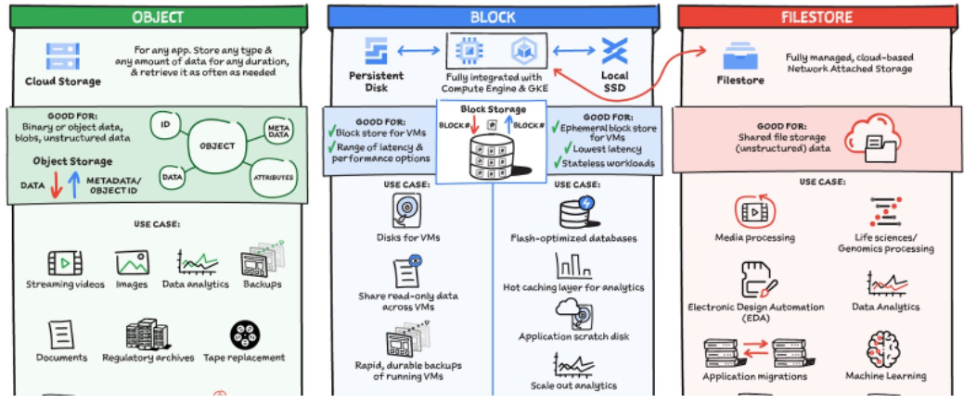
Storage: Object, Block and File Storage

Slide 77

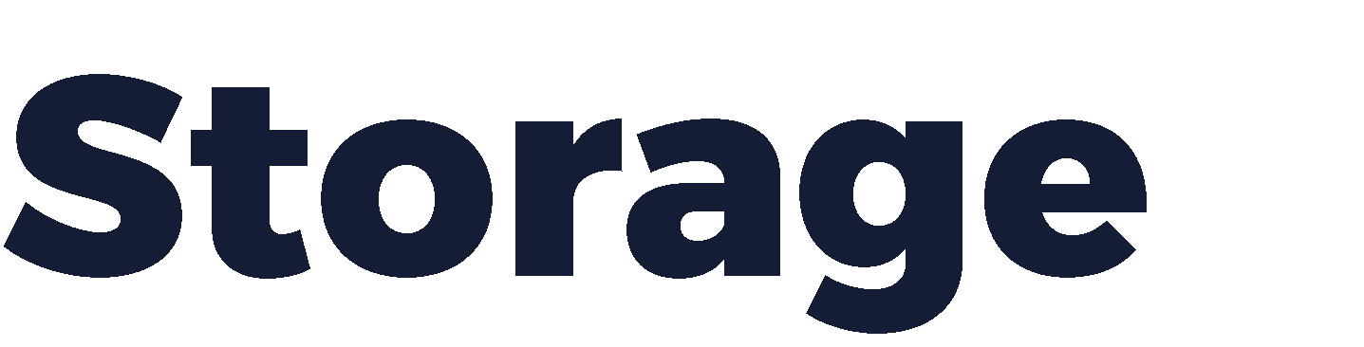

The most common threat is unauthorized access to data in storage in order
to modify, exfiltrate, or delete
Storage systems can also be subject to DDoS botnet attacks
Object storage does not have a runtime environment, so malware risk is
reduced when compared to file, volume, and database storage
Objects are usually accessed using API requests or URLs which both have their own list of vulnerabilities
Loss based on physical disk failure in the cloud datacenter remain regardless
of the storage or database type
Ransomware attacks are becoming more common against data stored as objects or blobs at the CSP (S3, Azure Blob, GCS)
Data containing PHI, PII, IP, and other sensitive content is a prime target for
advanced persistent threats (APT) and data remanence attacks

Slide 78
2.3 Design and Apply Data Security Technologies and Strategies
Encryption and Key Management
Hashing
Masking
Tokenization
Data Loss Prevention (DLP)
Data Obfuscation
Data De-identification (e.g., anonymization)

Slide 79

Cloud computing has a huge dependency on encryption
Cloud providers have the massive resources to employ teams of advanced cryptographers and cryptanalysts to develop bleeding edge crypto solutions such as post-quantum cryptography and homomorphic encryption
Responsibility for cryptographic protection depends on the service deployment type (IaaS vs. PaaS)
Newer mechanisms such as AES-GCM-256, SHA-3 hashing, and elliptic curve cryptography are commonly utilized

Slide 80
Hashing
In a database management system, hashing transforms a string of characters into a typically shorter fixed- length value or key that represents the original string
Hashing is often used to index and retrieve items in a database because it is faster to find the data item using the shorter hashed key than using the original value

Slide 81
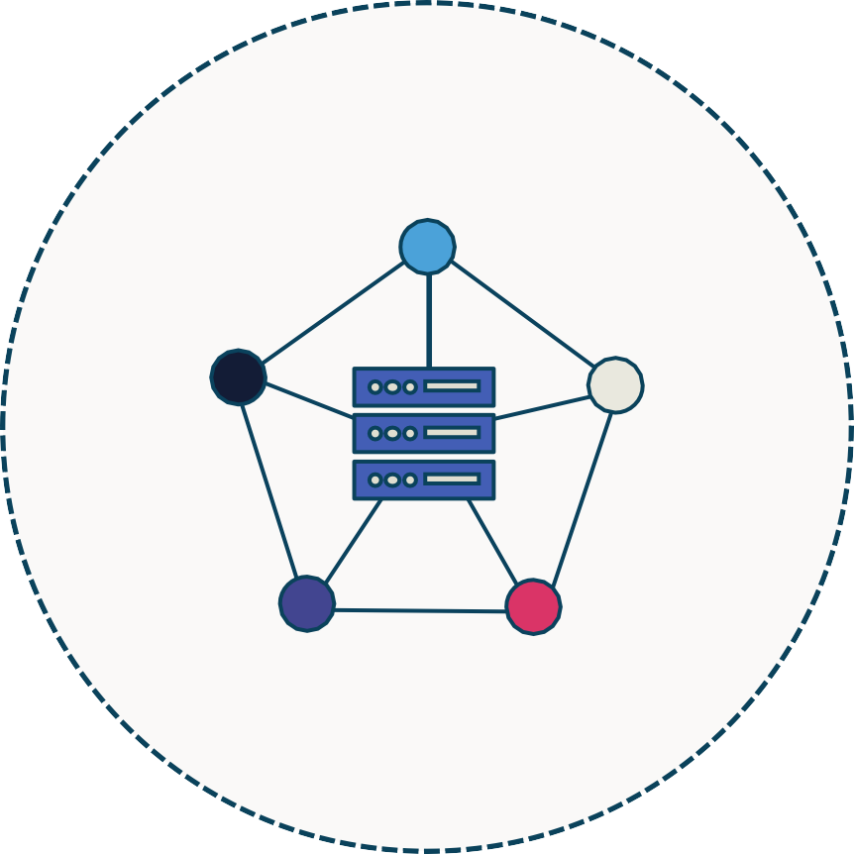
Database Security: Tokenization
Tokenization involves sending sensitive data through an API call (or batch file) to a provider that replaces the data with non- sensitive placeholders called tokens
The practice involves two distinct databases
One with the actual sensitive data
One with tokens mapped to each chunk of data
Unlike encrypted data, the tokenized data is
irreversible and unintelligible

Slide 82


Sensitive data held by government
Enriched individualized insights
Substance use in
families
Treatment cost and effectiveness
Child welfare agencies
Child welfare agencies
Arrest and parole information
Geographical crime data
Law enforcement
Corrections
department
Integrated Data set (tokenized)
Non-sensitive publicly available data
Enriched aggregated insights
Aggregated
treatments data
Aggregated prescriptions data
Hospitals
Hospitals
Marketing data
Spending and insurance information
Third-party data
Third-party
data

Slide 83




De-identify: Tokenize
Cloud Data Loss Prevention
Raw Data
Data From Partner Cloud Storage
Raw Data
Internal Data Cloud Pub/Sub
Report & Share
Business Analysis
Tokenized Data
Ingest to BigQuery
Cloud Dataflow
Join & Analysis
Cloud BigQuery
Data Engineer
Source: https://cloud.google.com/blog/products/identity-security/take-charge-of-your-data-how-tokenization-makes-data-usable-without-sacrificing-privacy

Slide 84

Hiding the data with random or useless characters
Masking often involves using characters like
“X” to hide some or all data
Example is to only display the last 4 digits of:
Social Security number
Credit card number
National ID number
Bank account number
Username or email address

Slide 85


Also “anonymization”
Anonymization and de-identification involves removing personally identifiable information from a data set that may be used for:
Medical research
Auditing and testing
Financial inquiry
Statistical analysis
Forensic investigations

Slide 86


A general term that applies to any or all mechanisms to present less decipherable or meaningful data
The goal is to render data unreadable or to hide aspects of personally identifiable, personal health, or corporate intellectual property information
“Obscuring” is a similar concept where static or dynamic techniques are used on the original data or a representational data set
“Shuffling” is a term that describes utilizing characters from the same data set to further present the data
“Randomization” is when all or some of the data is replaced with
indiscriminate characters
It is critical that the chosen method prevent inference whereby one could extrapolate the original data set - additional abstraction may be necessary

Slide 87
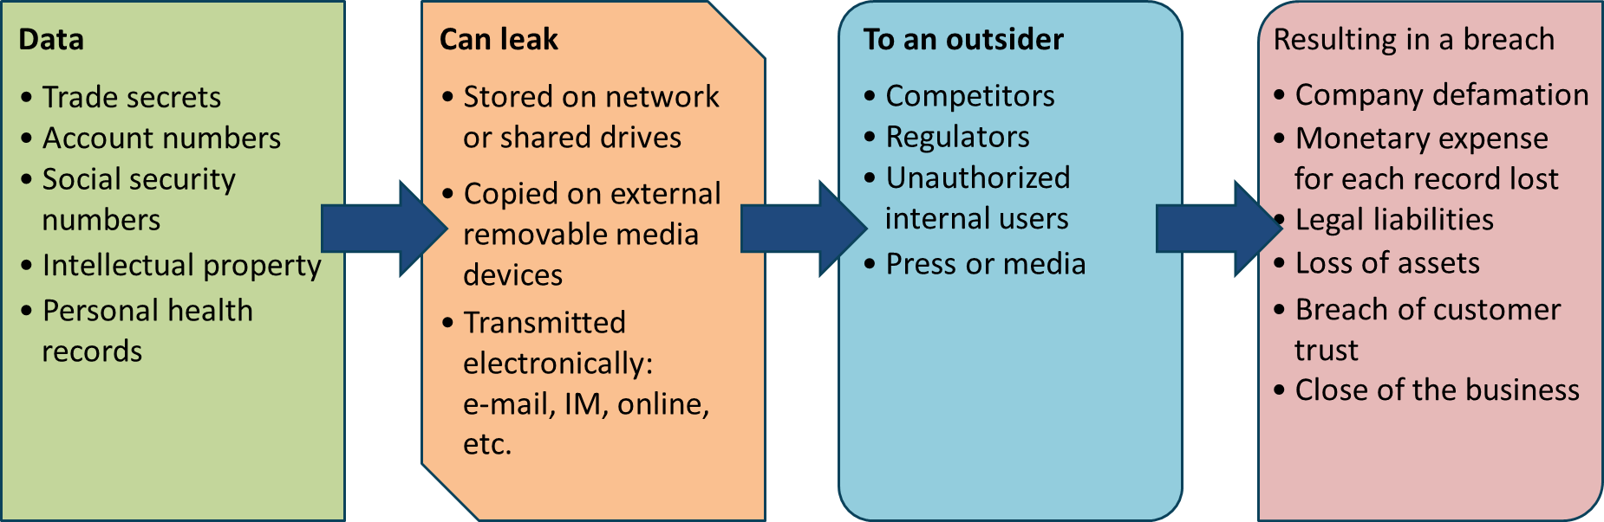

Slide 88
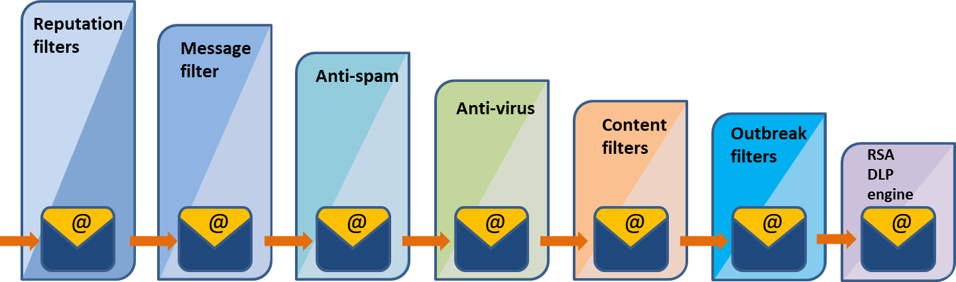
The process of examining data as it exits a zone or administrative domain to prevent data loss or
leakage of IP, PII, PHI and more. It typically has 4 key goals:
Enhanced security controls as part of layered defense-in-depth
Enforcement of corporate security policy to accompany the AUP
Heightening the monitoring and visibility of egress data and information flow
Adherence to governance and regulatory compliance (HIPAA, SOX, PCI, GDPR)

Slide 89
2.4 Implement Data Discovery
Structured Data
Unstructured Data

Slide 90


Data discovery is a methodology that often serves two goals:
The enterprise is performing an initial asset assessment and inventory of data ownership
The organization is performing e-discovery as part of a digital forensic
investigation
There are three main forms of structured or unstructured data discovery
Content-based – dataset contents such as terms and pattern-matching
Label-based – discovery is based on existing labels an/or tagging that is applied to physical and logical assets both on-prem and in the cloud
Metadata-based – leveraging the extensible metadata available on data stored as objects – using APIs against data in AWS S3, Google Cloud Storage, Azure Blob storage for example

Slide 91
2.5 Implement Data Classification
Classification
Mapping
Labeling
Sensitive data (e.g., Protected Health Information (PHI), Personally Identifiable
Information (PII), card holder data)

Slide 92




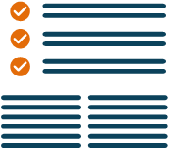
The earliest stages of information security life cycle involve identification, assessment (valuation), and classification of data assets
Labeling and tagging (logical) concerns the classification of information and is used to determine the level of protection and how the asset should be handled
Handling controls who has access to information and is
based on labeling – how it has been classified
Classification can be based on location, value, age, utility, useful lifetime, personal association, or a sensitivity label for a mandatory access control (MAC Bell-LaPadula or Biba) model
A key aspect of risk management

Slide 93

Government/military:
Commercial/private sector:
Top Secret
Secret
Confidential
Sensitive But Unclassified (SBU)
Unclassified
Confidential
Private
Sensitive
Public

Slide 94

Personally Identifiable Information (PII)
Consists of first name or initial with last name and one or more pieces of info
Social Security number, driver's license number, ID
card, financial account number
Protected Health Information (PHI)
Contains at least one piece of info
Name, address, birth date, phone number, mail or e-mail Address, Social Security number, URLs
Medical history
Health records and lab reports

Slide 95
2.6 Design and Implement Information Rights Management (IRM)
Objectives (e.g., data rights, provisioning, access models)
Appropriate Tools (e.g., issuing and revocation of certificates)

Slide 96


The CCSP exam prefers the term IRM over DRM
Also called DRM and E-DRM
The objectives of IRM are to employ controls that work with, or in addition to, access control security to protect data and file-level assets
Example: Must control copying, deleting, and modifying certain PDF documents to protect intellectual property (IP) and copyrights
A copyright usually persists for either 70 after the death of the author or 120 years after first use of a work for hire
Since digital signing and certificates are often used, an enterprise PKI may be part of the policy

Slide 97


Identity and access management
Encryption keys
IRM
Access control lists
Data loss prevention

Slide 98



DRM is access-control technology that protects licensed digital intellectual property (IP)
DRM is used by publishers, manufacturers, and IP owners for digital content and device monitoring
Digital media licensees attempt to balance the rights of IP owners and Internet users by protecting rights and profits for digital product manufacturers and retailers
Digital rights management (DRM) mechanisms are varied access control technologies used to control usage of proprietary hardware and copyrighted works

Slide 99
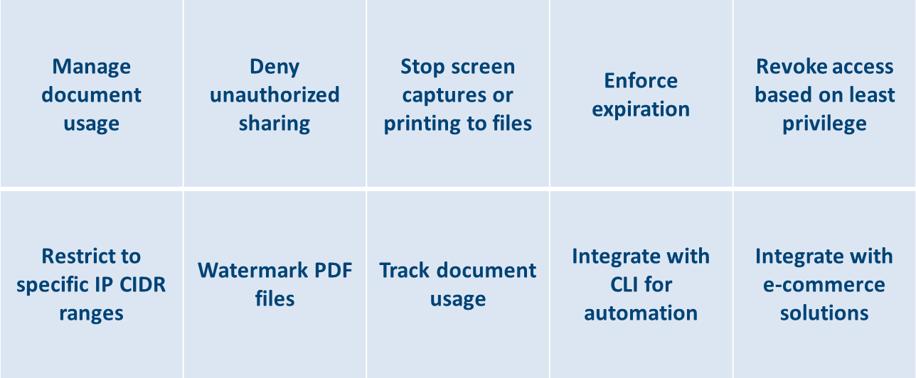

Slide 100
2.7 Plan and Implement Data Retention, Deletion and Archiving Policies
Data Retention Policies
Data Deletion Procedures and Mechanisms
Data Archiving Procedures and Mechanisms
Legal Hold

Slide 101

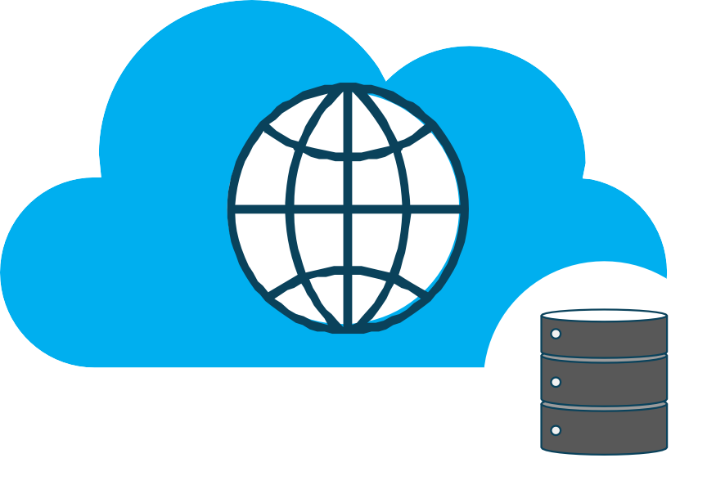
Data retention typically applies to production data in the Use and Share phases as it is kept for practical purposes as well as corporate utility policies and regulatory mandates
The policy may also mandate formatting and storage of data as well
A data retention policy may be closely aligned with the
Archive phase of the cloud data lifecycle
The retention period (usually several years) is an established amount of time that data remains in the archive phase before transitioning to the disposal or destruction phase
These period may be modified due to change of
providers, SLAs, or new regulations

Slide 102
There is no one-size-fits-all for archiving data
It may be as an aspect of BCP with the backup and restore policy
A backup policy is only as good as the restoration testing
that has been performed
There may be different data storage and archiving policies for volume (block) data and object data
It is highly recommended that incremental and differential
backups ALWAYS be programmed and automated
CSPs offer cold storage and “deeper” cold storage
Some cloud options involve different retrieval plans
Expedited – 1 to 5 minutes
Standard – 3 to 5 hours
Bulk – 5 to 12 hours

Slide 103

As far as cloud computing is concerned, the two main methods for customer data deletion are:
Using random data or null pointers to overwrite over data sectors that stored sensitive or proprietary intellectual property
The acceptable methods will be driven by regulatory standards and guidelines including the number of iterations
Not a practical method for confidence at a cloud provider
The most effective and practical method in the cloud is cryptographic shredding or erasure

Slide 104

A legal hold refers to a process which an organization uses to retain all forms of pertinent data and information when it reasonably expects some type of litigation against it, or some need for future utility in a court of law
It can be a restriction placed on a database or set of records that exists as a result of existing or anticipated litigation, audit, government investigation or other such activity that suspends the regular usage, processing, or disposition of data.

Slide 105
2.8 Design and Implement Auditability, Traceability and Accountability of Data Events
Definition of Event Sources and Requirement of Identity Attribution
Logging, Storage and Analysis of Data Events
Chain of Custody and Non-repudiation

Slide 106

Critical for continual improvement of data security in the enterprise
The audit policy should consider the following:
Auditing periods
Audit scope
Internal or external or both
Restrictions
Avoiding conflicts if interest
Established processes and procedures
Approved tools and techniques

Slide 107

